Slide 1
Final Group Project
Movie Review Network
Corey Laycock, Thirza van den Brink, Alicja Sierek & Fiammetta Rosenblatt
Notes:
To note: result values different than in paper since another run, before setting random state

Slide 2
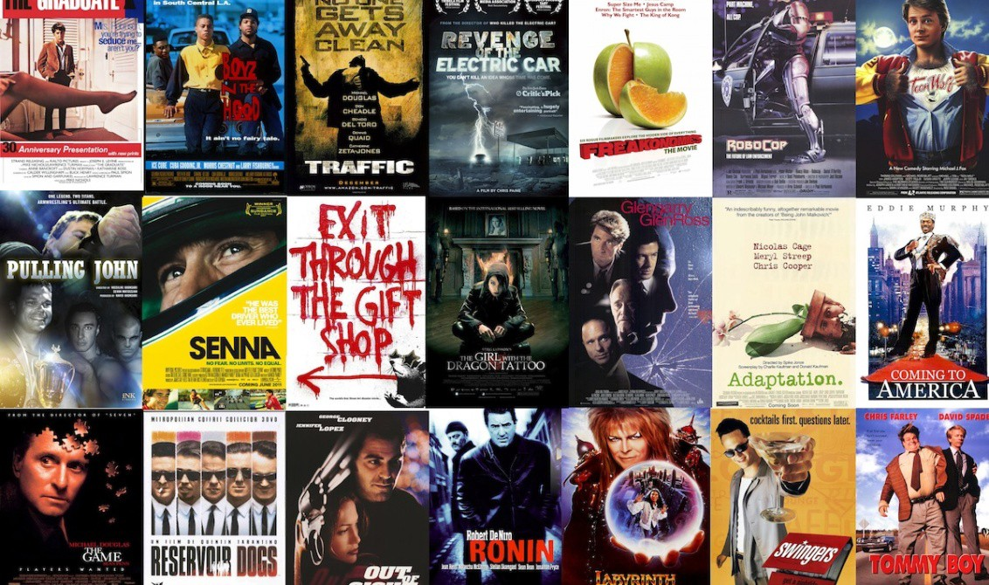
Table of Contents
Introduction and Background
Methodology
Data Preprocessing
Network Building
Clustering
Results
Limitations
Conclusion

Slide 3
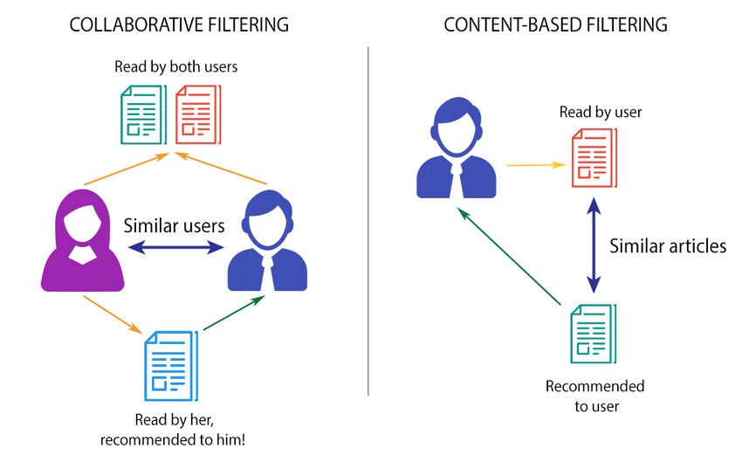
Introduction and Background
Recommender systems in machine learning
Content based filtering
Collaborative filtering
Social-interaction research in sociology
Network science as a lens
→ Connecting the elements by improving understanding
Movie recommendation focusing on genre
Amazon Movie Reviews

Slide 4
Project Specifics
→ To which extend can node clusters be associated with genre?
Hypothesis:
A movie cluster will be roughly homogenous in genre (over 50% of one)
Experiment:
Building a network of co-reviews
Applying the Louvain algorithm to delimit communities
Calculate majorities (in %) within clusters
Relevance: Opportunities of network science in recommender systems

Slide 5
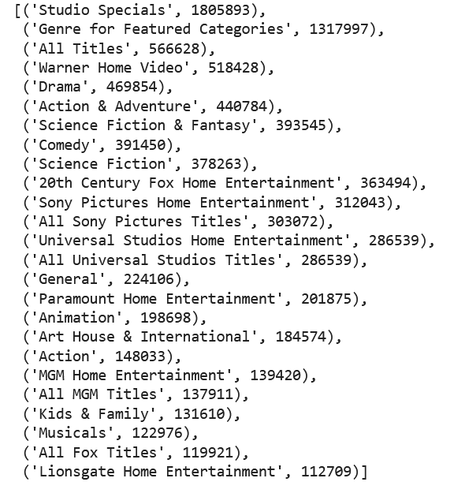
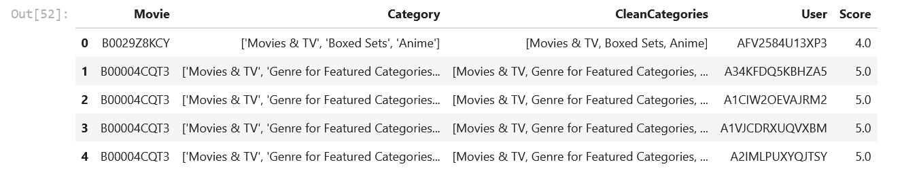
Methodology - Data Pre-processing
Amazon Movie Reviews
Pandas Dataframe
Filters
Genres:
documentary, action, horror, musicals, anime & manga
Constraints

Slide 6
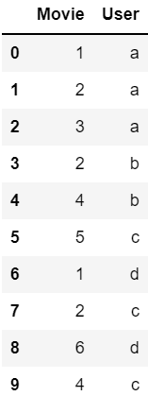
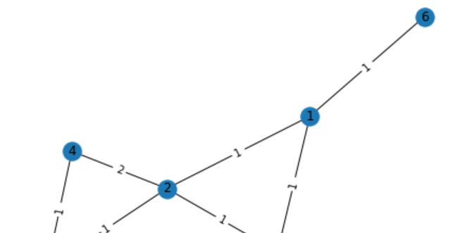
Methodology - Network Building
Dataframe to network
Weighted
Complexity

Slide 7
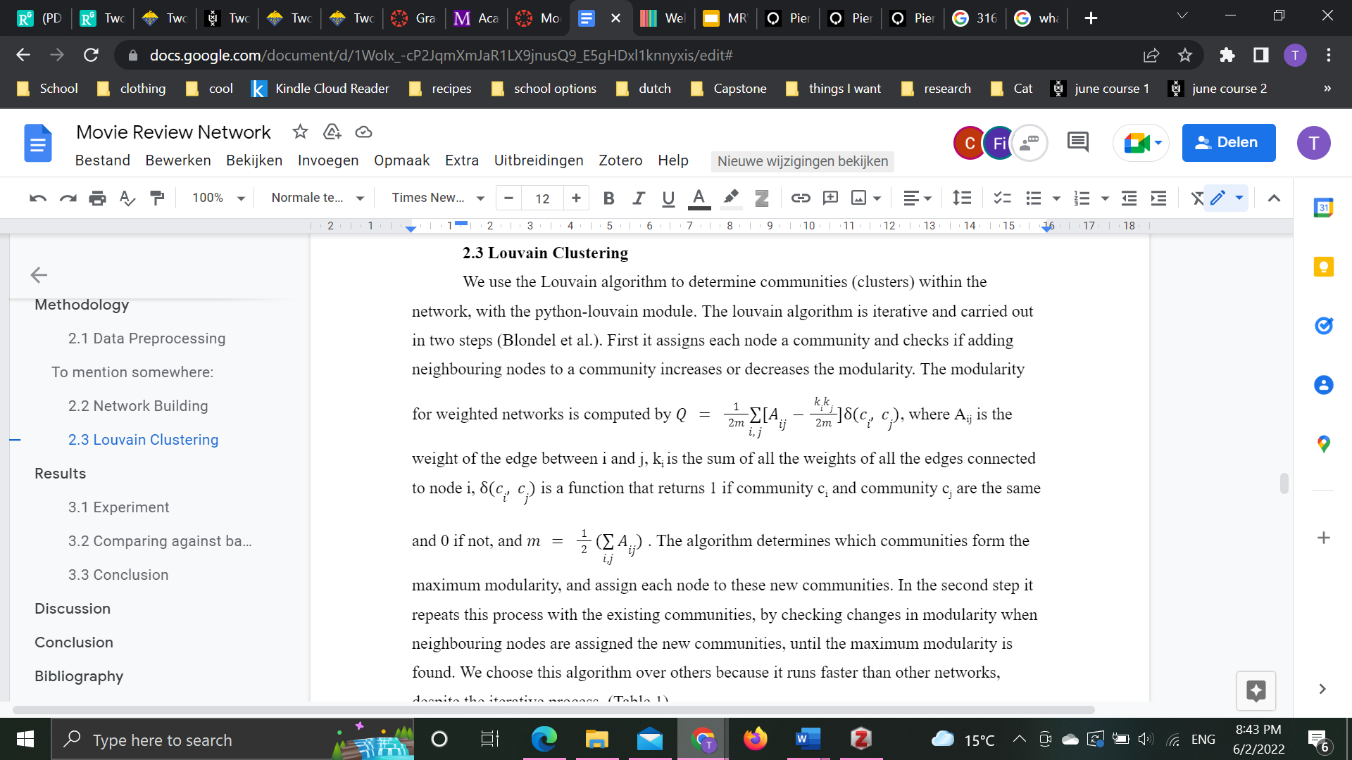
Methodology - Clustering
Clusters
Python_louvain
Modularity
Benefits

Slide 8
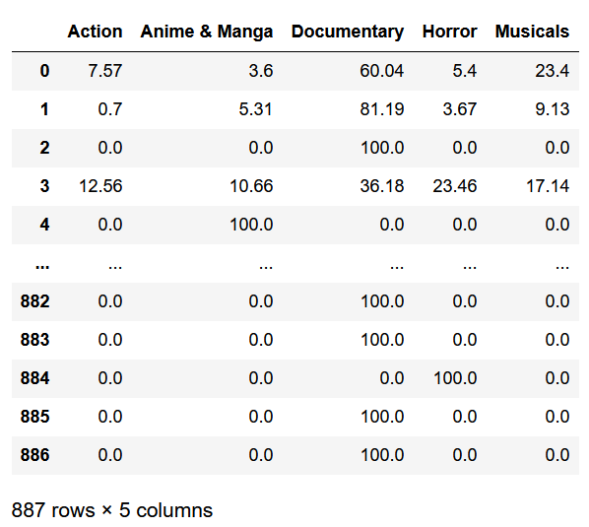
Results
887 clusters
96,73% with genre majority > 50%
93,80% with strong majority > 80%
Notes:
noot

Slide 9
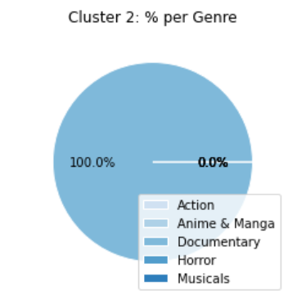
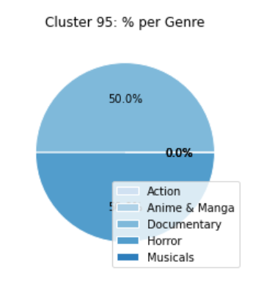
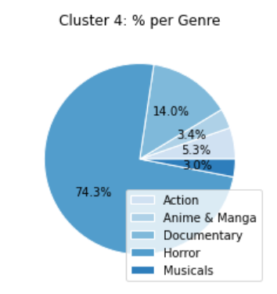
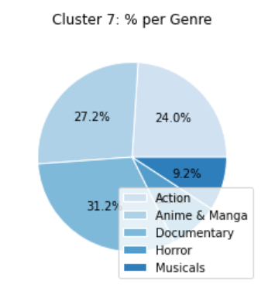
824
24
842
5
One genre (100%)
Two genres (both 50%)
One genre clear majority
(any > 70%)
All genre minority
(all < 50%)

Slide 10
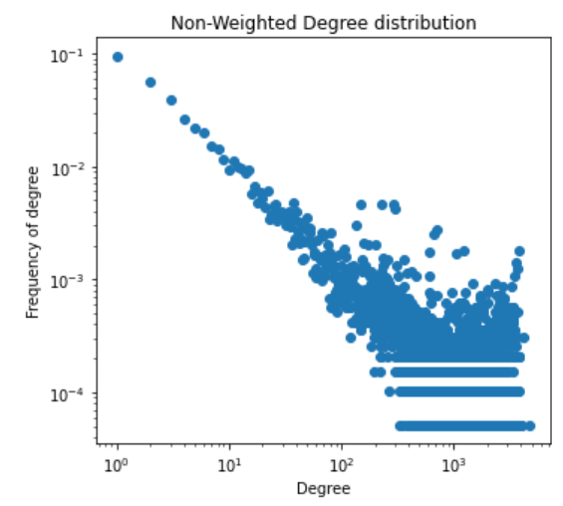

Results Analysis & Limitations
Large clusters (>10 movies) only 3.04% (27)
Challenges significance of %
Average degree: 429,65
Scale-free property
Relatively many hubs
Many low degree nodes
Experiment: Remove weight-1 edges (66,05%) & resulting 0-degree nodes
Dataset reduction limits
All different amounts of movies within the clusters

Slide 11
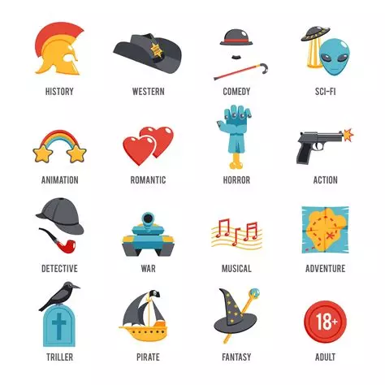
Conclusion
Hypothesis confirmed
Clusters overlap with genre
96,73% genre majority
Significance constrained
Future research with more computing power
Complete dataset & all (sensible) genres
Using text mining to integrate better reviews
Network science explanatory power for recommender system
Accurate modeling

Slide 12
References
Blondel, V. D., Guillaume, J.-L., Lambiotte, R., & Lefebvre, E. (2008). Fast unfolding of communities in large networks. Journal of Statistical Mechanics: Theory and Experiment, 2008(10), P10008. https://doi.org/10.1088/1742-5468/2008/10/p10008
Carrer-Neto, W., Hernández-Alcaraz, M. L., Valencia-García, R., & García-Sánchez, F. (2012). Social knowledge-based recommender system. Application to the movies domain. Expert Systems with Applications, 39(12), 10990–11000. https://doi.org/10.1016/j.eswa.2012.03.025
Chen, W. (2021). Learning from user interactions for recommending queries and items.
Clauset, A., Newman, M. E. J., & Moore, C. (2004). Finding community structure in very large networks. Physical Review E, 70(6). https://doi.org/10.1103/physreve.70.066111
Dokoohaki, N. (Ed.). (2020). Fashion Recommender Systems. Springer Nature.
Linden, G., Smith, B., & York, J. (2003). Amazon.com recommendations: item-to-item collaborative filtering. IEEE Internet Computing, 7(1), 76–80. https://doi.org/10.1109/mic.2003.1167344
McAuley, J. J., & Leskovec, J. (2013). From amateurs to connoisseurs. Proceedings of the 22nd International Conference on World Wide Web - WWW ’13. https://doi.org/10.1145/2488388.2488466
Nanou, T., Lekakos, G., & Fouskas, K. (2010). The effects of recommendations’ presentation on persuasion and satisfaction in a movie recommender system. Multimedia Systems, 16(4-5), 219–230. https://doi.org/10.1007/s00530-010-0190-0
Ras, Z. W., Wieczorkowska, A., & Tsumoto, S. (2021). Recommender systems for medicine and music. Cham Springer.
Winkels, R., Boer, A., Vredebregt, B., & van Someren, A. (2014). Towards a Legal Recommender System. In dare.uva.nl. AmsterdamIOS Press. https://hdl.handle.net/11245/1.446002
Zhang, S., Jin, Z., & Zhang, J. (2016). The dynamical modeling and simulation analysis of the recommendation on the user–movie network. Physica A: Statistical Mechanics and Its Applications, 463, 310–319. https://doi.org/10.1016/j.physa.2016.07.049
Zhao, Z., Yang, Q., Lu, H., Weninger, T., Cai, D., He, X., & Zhuang, Y. (2018). Social-Aware Movie Recommendation via Multimodal Network Learning. IEEE Transactions on Multimedia, 20(2), 430–440. https://doi.org/10.1109/tmm.2017.2740022

Slide 13
Thank you for your attention!
Any questions?

